Slide 1



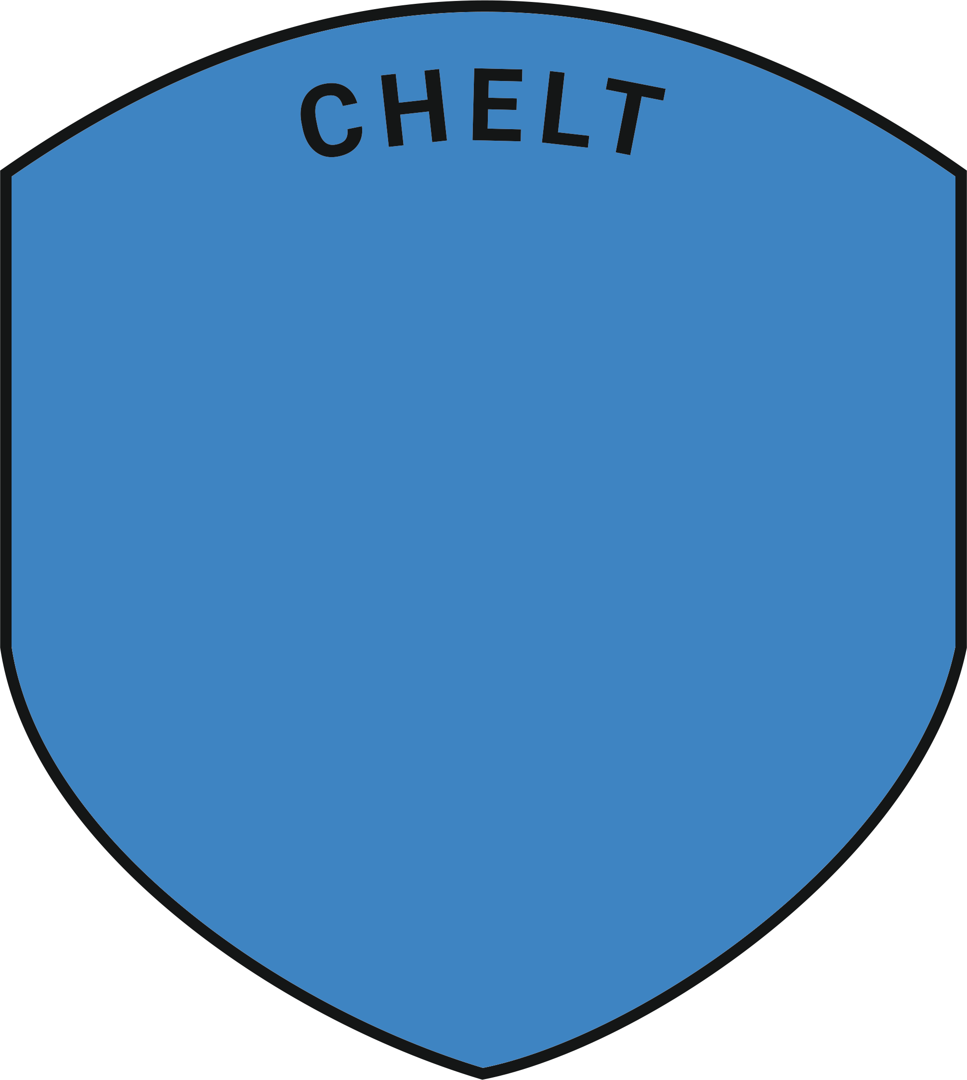



The House Crest Design Competition is an exciting event in which students from different houses showcase their creativity and artistic skills by designing a crest that represents the, strengths and values of their respective houses. The aim of this competition is to foster a sense of pride and unity among students, as well as to create a crest that embodies the unique identity of each house.

Slide 2

Symbols play a significant role in representing attributes and values associated with each school house. They serve as visual representations that communicate the essence of a house's virtues, strengths, and ambitions.
What symbols will you include?
What do they represent about your house?
How can you combine more than one symbol in a clear
and visually interesting way?

Slide 3
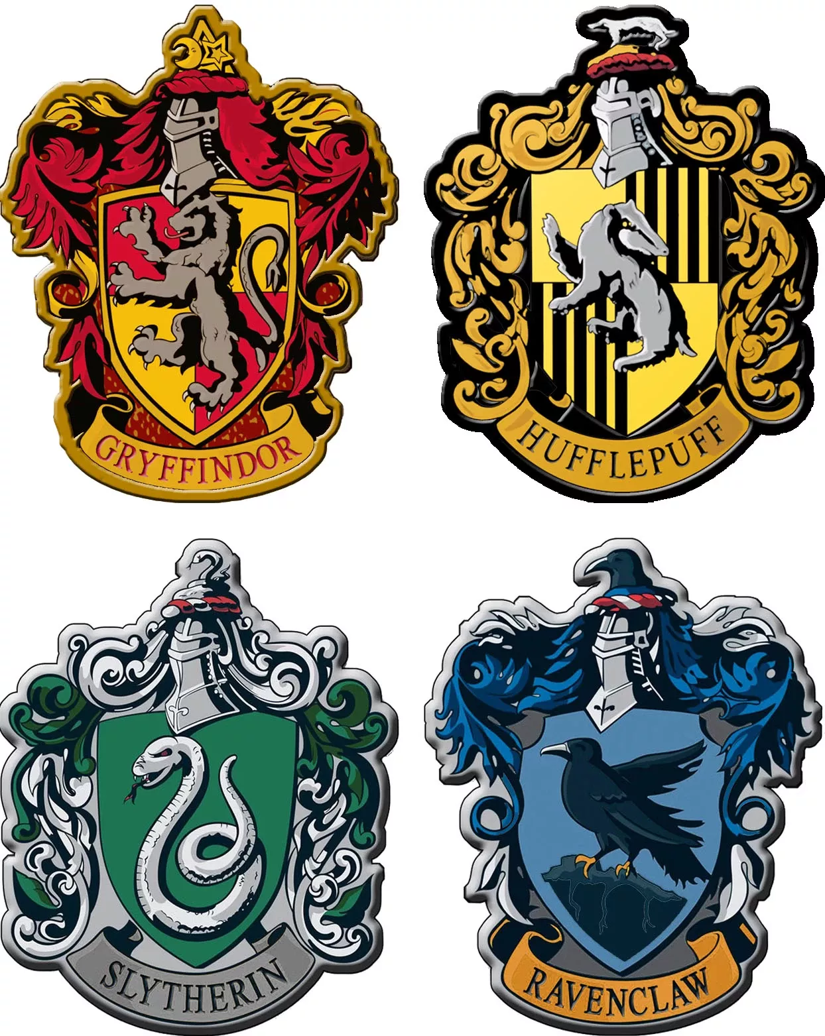
Gryffindor is often associated with bravery, courage, and chivalry. The symbol commonly used for Gryffindor is a lion, which represents strength, leadership, and bravery. The lion embodies the fearless nature of Gryffindor students and their determination to stand up for what is right.
Hufflepuff values loyalty, kindness, and hard work. The symbol associated with Hufflepuff is a badger, known for its loyalty, determination, and industrious nature. The badger represents the steadfast dedication and unwavering loyalty that Hufflepuff students exhibit towards their friends, tasks, and values.

Slide 4
Ambition, cunning, and resourcefulness are the defining traits of Slytherin. The snake is often used as a symbol for Slytherin, as it represents wisdom, cleverness, and adaptability. The snake symbolizes the ambition and cunning nature of Slytherin students, as they strive for success and use their resourcefulness to achieve their goals.
Ravenclaw emphasises wisdom, intelligence, and knowledge. The symbol associated with Ravenclaw is a raven or eagle, known for its wisdom and sharp intellect. The raven or eagle represents the thirst for learning and the pursuit of knowledge that Ravenclaw students embody.

Slide 5

Use the template provided to design a crest for YOUR house
The background must include you house colour in some way
The name of your house must be clearly visible as part of your design
Winning designs will be adapted by a professional graphic designer to be used throughout the school
All entries to be submitted to Mrs McAlpine by Friday 30th June with name and tutor group clearly labelled
Designs can be hand drawn and handed in, or created digitally and emailed to gma@hsl.gloucs.sch.uk

