Slide 1


Anti-Bullying
Week 2021

Slide 2
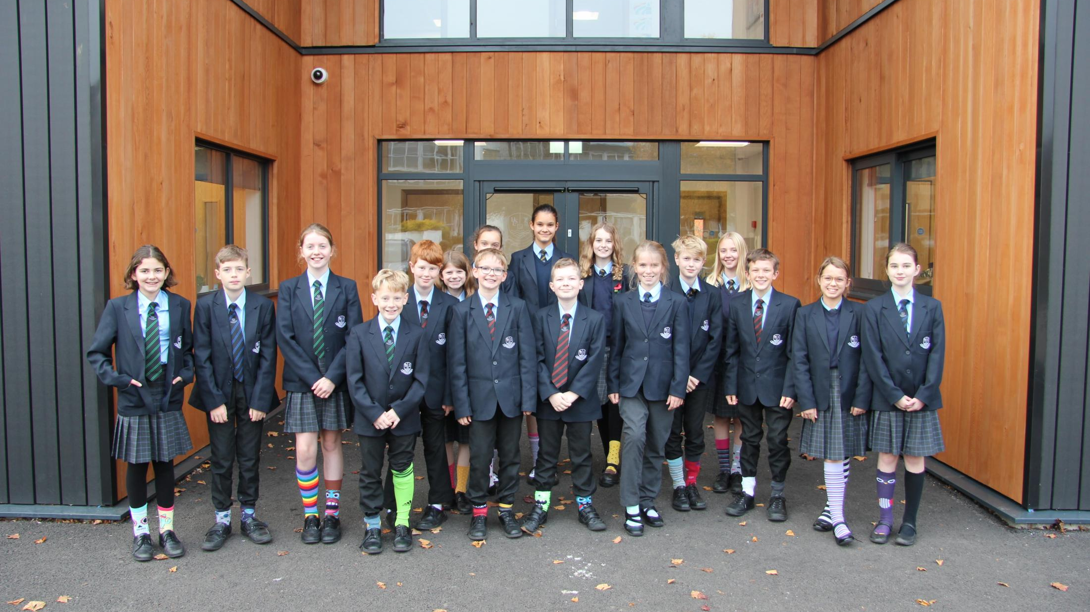
HSL’s Odd Socks Day 21!

Slide 3
?
What is bullying?
Bullying is the repetitive, intentional hurting of one person or group by another person or group, where the relationship involves an imbalance of power. It can happen face to face or online.
Video: https://youtu.be/U8iX-rstY9I
Anti-Bullying Week 2021 – One Kind Word
3

Slide 4
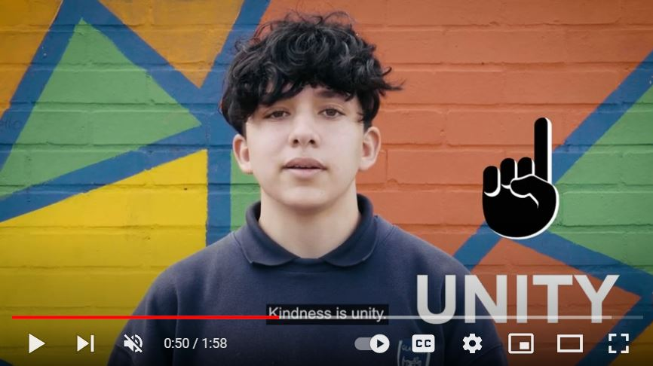


“
“
https://youtu.be/SmgiR5s0cHU
Anti-Bullying Week 2021 – One Kind Word
4

Slide 5
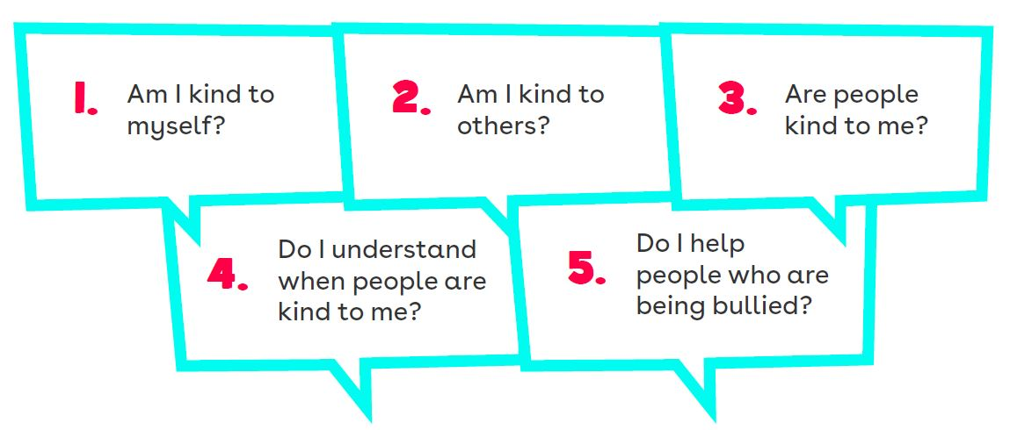
5 Key Kindness Questions
Anti-Bullying Week 2021 – One Kind Word
5

Slide 6
1
Situation
You find out that a group of your friends have been anonymously posting unkind and threatening comments on Kadeem’s TikTok videos. You know Kadeem is sad and scared about it but he’s not in your friendship group so you don’t know how to approach him.
What could you do to spread kindness and stop bullying?
Anti-Bullying Week 2021 – One Kind Word
6

Slide 7
Situation
2
Eloise joined school half way through the year. You saw her sitting on a table on her own in the canteen. You know from speaking to her before that you don’t have much in common but you also don’t want her to be on her own.
What could you do to spread kindness and stop bullying?
Anti-Bullying Week 2021 – One Kind Word
7

Slide 8
Situation
3
Harry trips Aiden every time he walks down the aisle of the school bus in the morning. Everyone laughs but the driver hasn’t noticed. You’re worried Harry will pick on you if you do anything but you want to help Aiden.
What could you do to spread kindness and stop bullying?
Anti-Bullying Week 2021 – One Kind Word
8

Slide 9
Situation
4
Sarah tells Molly that she thinks she’s ‘weird’ in front of you. She starts really laying into her and it’s awkward and over the top. Molly looks shocked and upset.
What could you do to spread kindness and stop bullying?
Anti-Bullying Week 2021 – One Kind Word
9

Slide 10
?
Is it possible to disagree kindly?
Anti-Bullying Week 2021 – One Kind Word
10

Slide 11
“
HSL
Our school is a kind school
Our school is a telling school
Our school will not tolerate bullying
“
Anti-Bullying Week 2021 – One Kind Word
11

Slide 12
Thank you for being a part of
Anti-Bullying
Week 2021

